Slide 1
Regression and Classification Performance Evaluation Metrics

Slide 2
Why are metrics important?
Training objective (cost function) is only a proxy for real world objectives.
Metrics help capture a business goal into a quantitative target (not all errors are equal).
Helps organize ML team effort towards that target.
Generally, in the form of improving that metric.

Slide 3
Regession Metrics
MAE (Mean Absolute Error)
MSE (Mean Square Error)
RMSE (Root Mean Square Error)
RMSLE (Root Mean Square Log Error)
Relative Square Error
R²
Adjusted R²

Slide 4
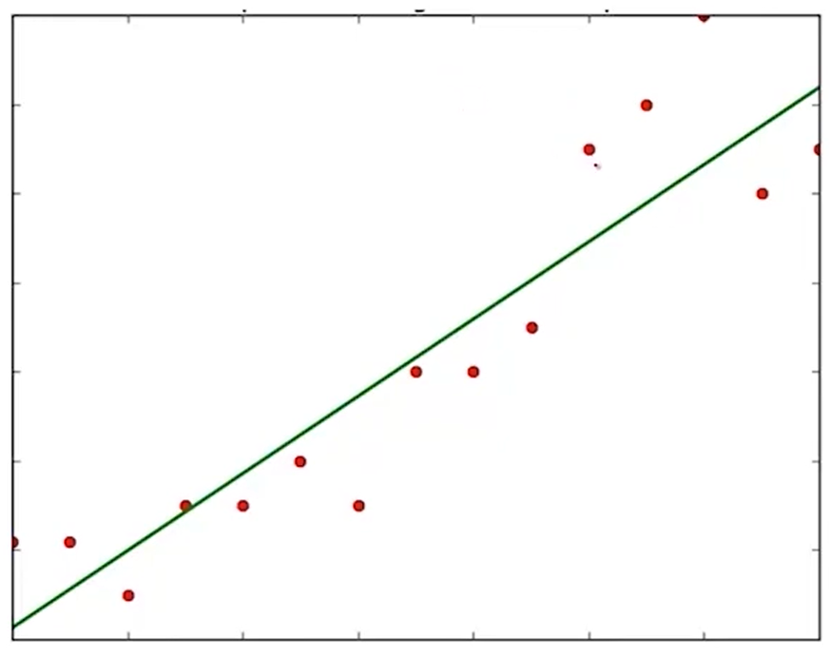
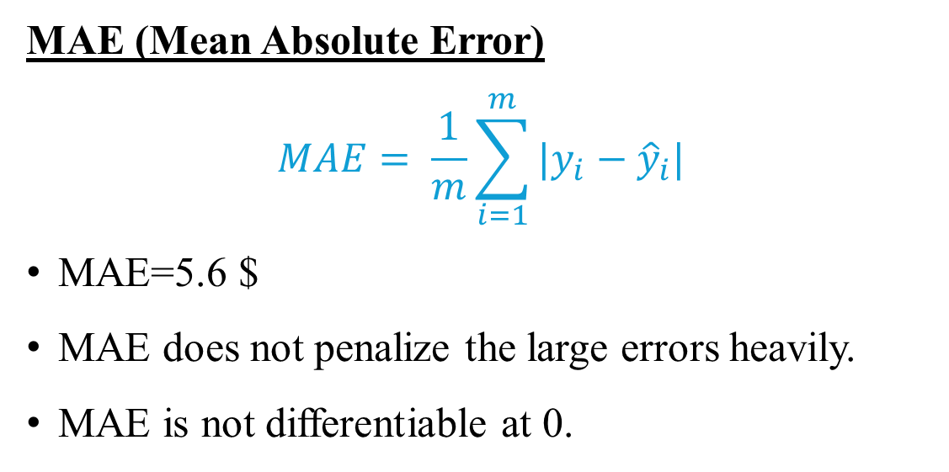
Regression Metrics
Actual Values ($) | Predicted Values ($) | Error ($)
28 | 19 | 9
33 | 37 | -4
20 | 25 | -5
16 | 9 | 7
15 | 22 | -7
What is Error?
Sum of error = 0
Doesn’t help!!
Solution: Consider absolute or square of the error
MAE (Mean Absolute Error)
$$MAE= \frac{1}{m}\sum_{i=1}^{m}{|y_{i}−{\hat{y}}_{i}|}$$
MAE=5.6 $
MAE does not penalize the large errors heavily.
MAE is not differentiable at 0.

Slide 5
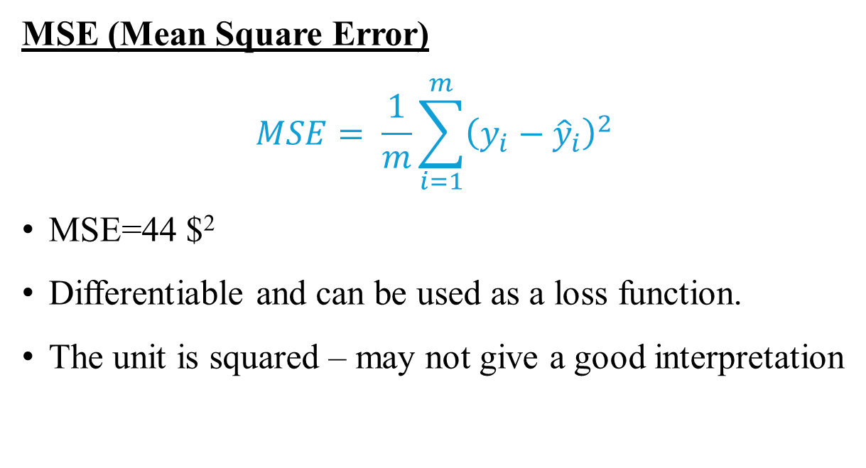
Regression Metrics
Actual Values ($) | Predicted Values ($) | Error ($)
28 | 19 | 9
33 | 37 | -4
20 | 25 | -5
16 | 9 | 7
15 | 22 | -7
MSE (Mean Square Error)
$$MSE= \frac{1}{m}\sum_{i=1}^{m}{{\left(y_{i}−{\hat{y}}_{i}\right)}^{2}}$$
MSE=44 $²
Differentiable and can be used as a loss function.
The unit is squared – may not give a good interpretation

Slide 6
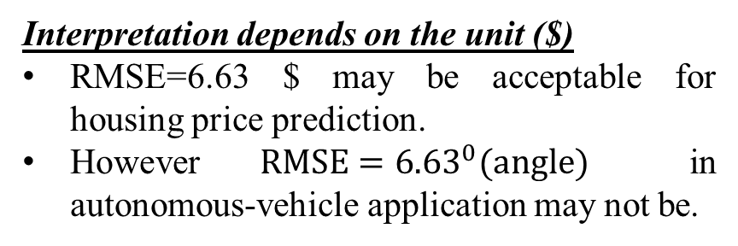
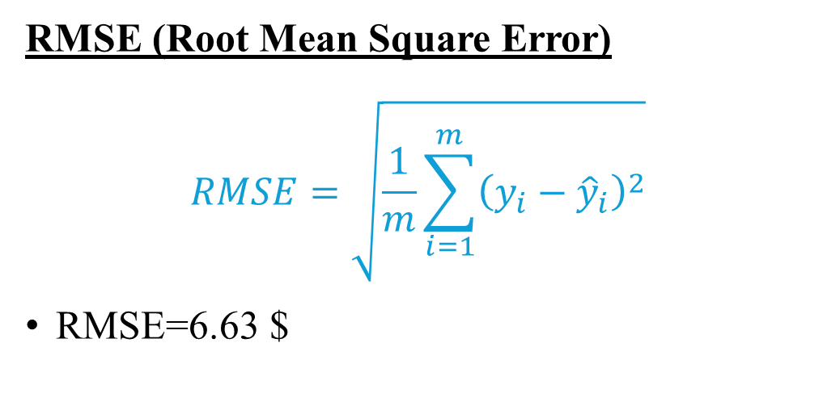
Regession Metrics
Actual Values ($) | Predicted Values ($) | Error ($)
28 | 19 | 9
33 | 37 | -4
20 | 25 | -5
16 | 9 | 7
15 | 22 | -7
RMSE (Root Mean Square Error)
$$RMSE=\sqrt{\frac{1}{m}\sum_{i=1}^{m}{{\left(y_{i}−{\hat{y}}_{i}\right)}^{2}}}$$
RMSE=6.63 $
Interpretation depends on the unit ($)
RMSE=6.63 $ may be acceptable for housing price prediction.
However ${RMSE=6.63}^{0}(angle)$ in autonomous-vehicle application may not be.
RMSE may be misleading!!
Case1: Actual=1; Predicted=401
Case2: Actual=10,001; Predicted=10,401
RMSE = 282$ in both cases.
However, Model 2 is a good model and Model 1 is not.
Scale issue!

Slide 7
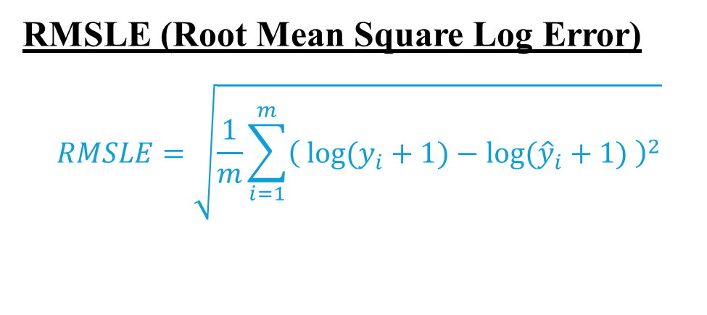
Regession Metrics
RMSLE (Root Mean Square Log Error)
$$RMSLE=\sqrt{\frac{1}{m}\sum_{i=1}^{m}{{\left( log⁡(y_{i}+1)−log⁡({\hat{y}}_{i}+1) \right)}^{2}}}$$
Case1: Actual=1; Predicted=401
Case2: Actual=10,001; Predicted=10,401
RMSLE₁ = 2.65$ and RMSLE₂ = 0.00014$
Now, Model-2 can be accepted, and Model-1 can be rejected.
Scale issue- resolved!
Interpretation still depends on the unit ($)
Acceptable scale/magnitude of RMSLE may depend on the application.
Benchmark comparison?
Is there any metric that can compare with the benchmark model automatically?

Slide 8
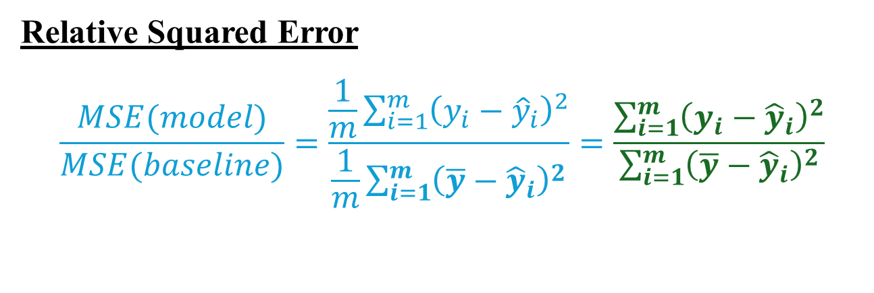
Regession Metrics
Relative Squared Error
$$\frac{MSE(model)}{MSE(baseline)}=\frac{\frac{1}{m}\sum_{i=1}^{m}{{\left(y_{i}−{\hat{y}}_{i}\right)}^{2}}}{\frac{1}{m}\sum_{i=1}^{m}{{\left(\overline{y}−{\hat{y}}_{i}\right)}^{2}}}=\frac{\sum_{i=1}^{m}{{\left(y_{i}−{\hat{y}}_{i}\right)}^{2}}}{\sum_{i=1}^{m}{{\left(\overline{y}−{\hat{y}}_{i}\right)}^{2}}}$$
RSE compares the model performance with mean performance.
RSE is unit-less and expected to be in [0,1]

Slide 9
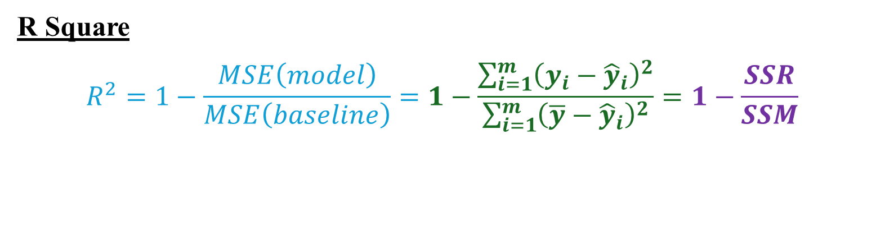
Regession Metrics
R Square
$$R^{2}=1−\frac{MSE\left(model\right)}{MSE\left(baseline\right)}=1−\frac{\sum_{i=1}^{m}{{\left(y_{i}−{\hat{y}}_{i}\right)}^{2}}}{\sum_{i=1}^{m}{{\left(\overline{y}−{\hat{y}}_{i}\right)}^{2}}}=1−\frac{SSR}{SSM}$$
Higher is the R², better is the model.
R² will remain same or increase with addition of new features.
So the model does not penalise the random noisy features, like wind-condition, temp, sky-colour on the day of sale, mood of the seller.
Is there any robust metric and way to penalise the irrelevant features?
Notes:
R² will remain same or increase with addition of new features. ( Suppose there were 5 features with weights w1,…, w5. Now a 6th feature is added with weight w6 in linear regression. IF the new feature is relevant (no. of bedrooms, no. of floors, distance from airport) then w6 will have a good weightage value. IF the new feature is not relevant (like wind-condition, temp, sky-colour on the day of sale) then w6 will be very small; The LR model tries to learn very small corelation between this irrelevant feature and the output. In fact, w6 may be Zero in the worst case – in this case the model performance is as good as the previous performance without considering this feature. So the models performance actually never decreases. So the model does not penalise the random noisy feature.
Addition of relevant features will increase R² – Addition of no. of bedrooms can improve the model performance.
Addition of irrelevant features makes the learning confusing (corelation between the features and output will be confusing) – Model performance decreases and R² should decrease. – Additions of features like wind-condition, temp, sky-colour on the day of sale.
But, experimentally it is found that, R² doesn’t decrease in such cases.
Is there any robust metric and way to penalise the irrelevant features?

Slide 10
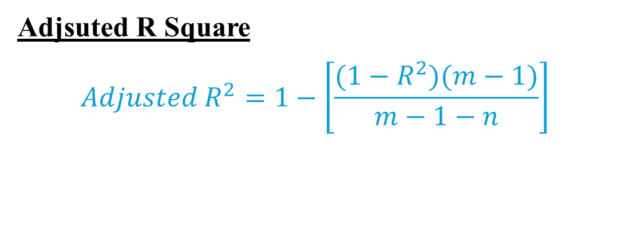
Regession Metrics
Adjsuted R Square
$${Adjusted R}^{2}=1−\left[\frac{(1−R^{2})(m−1)}{m−1−n}\right]$$
With addition of new features –
Case1: R² remains same – Adjusted R² decreases.
Case2: R² increases
IF new feature is relevant then the magnitude of increase in R2 will be more and Adjusted R² increases.
IF new feature is irrelevant then the magnitude of increase in R2 will be very tiny compared to the decrease in the denominator that would eventually increase the fraction and Adjusted R² will decrease.

Slide 11
Classification Metrics
Accuracy
Precision
Recall
F1 Score
AUC-ROC

Slide 12
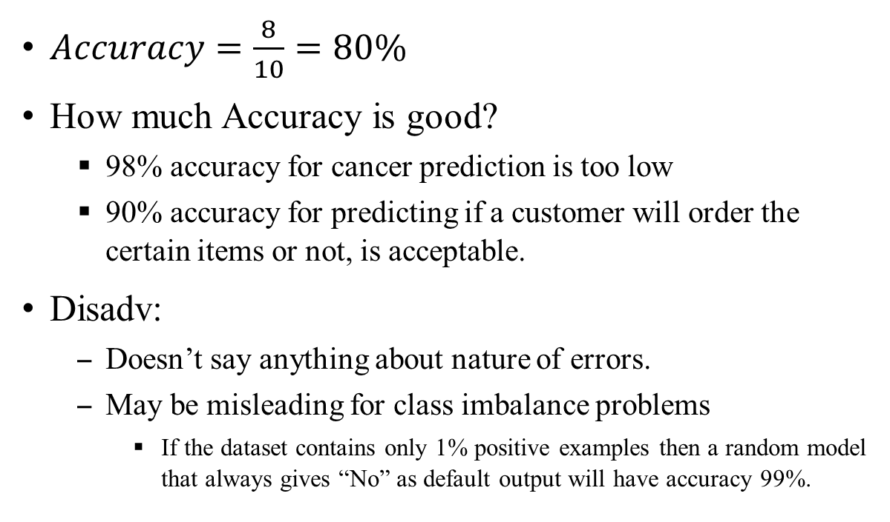

Classification Metrics
$$Accuracy=\frac{No. of correct predictions}{Total no. of predictions}$$
Actual Label | Predicted Label
1 | 1
0 | 1
0 | 0
0 | 0
1 | 1
1 | 1
1 | 0
0 | 0
0 | 0
1 | 1
$Accuracy=\frac{8}{10}=80\%$
How much Accuracy is good?
98% accuracy for cancer prediction is too low
90% accuracy for predicting if a customer will order the certain items or not, is acceptable.
Disadv:
Doesn’t say anything about nature of errors.
May be misleading for class imbalance problems
If the dataset contains only 1% positive examples then a random model that always gives “No” as default output will have accuracy 99%.

Slide 13
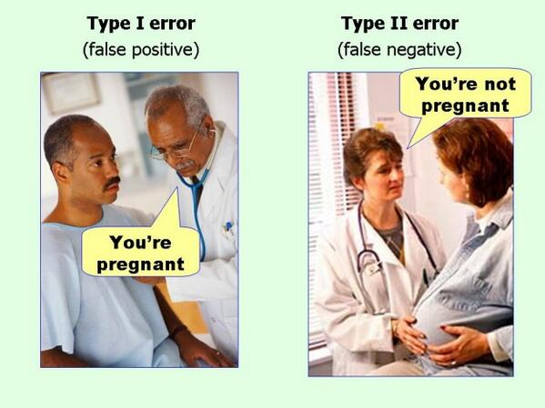

Classification Metrics
Predicted Class
Positive Negative
$Accuracy=\frac{TP+TN}{TP+FP+TN+FN}$
True Positive (TP) | False Negative (FN)
False Positive (FP) | True Negative (TN)
Type-II error
Model-1 | Predicted Spam | Predicted Not-Spam
Spam | 100 | 170
Not-Spam | 30 | 700
Negative Positive
Actual Class
Type-I error
Acc1 = Acc2 = 80%
Model-2 | Predicted Spam | Predicted Not-Spam
Spam | 100 | 190
Not-Spam | 10 | 700

Slide 14
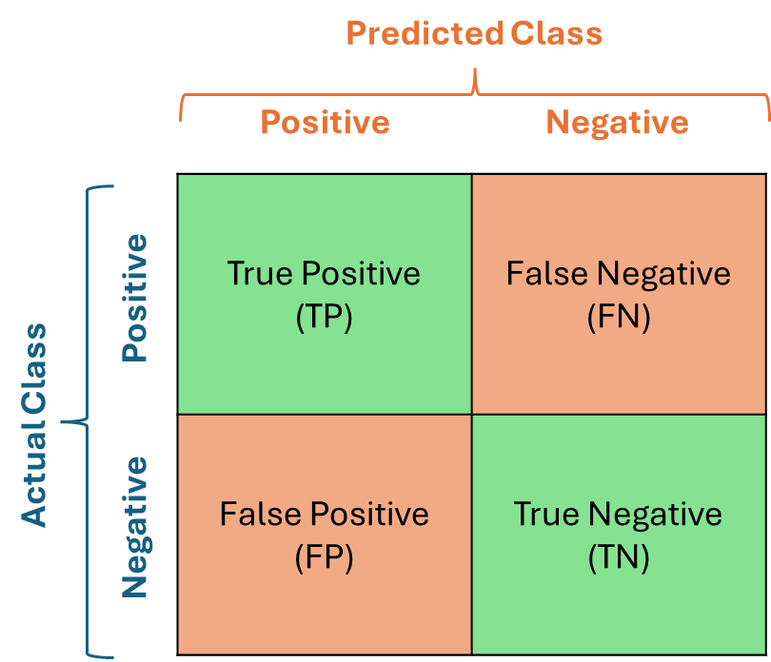
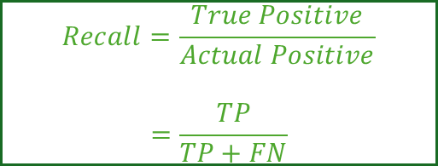
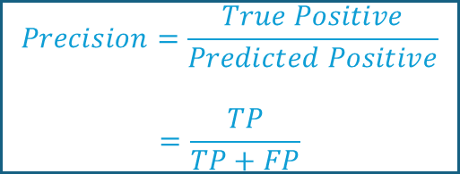
Classification Metrics
Model-1 | Predicted Spam | Predicted Not-Spam
Spam | 100 | 170
Not-Spam | 30 | 700
Model-3 | Predicted Cancer | Predicted No-cancer
Cancer | 1000 | 200
No Cancer | 800 | 8000
$$Precision=\frac{True Positive}{Predicted Positive}$$
$$=\frac{TP}{TP+FP}$$
Model-2 | Predicted Spam | Predicted Not-Spam
Spam | 100 | 190
Not-Spam | 10 | 700
Model-3 | Predicted Cancer | Predicted No-cancer
Cancer | 1000 | 500
No Cancer | 500 | 8000
$$Recall=\frac{True Positive}{Actual Positive}$$
$$=\frac{TP}{TP+FN}$$
Cannot afford Type-1 error (FP) – Pick Model.2
Cannot afford Type-2 error (FN) – Pick Model.3
 | P | R | Ac
M1 | 0.7692 | 0.3703 | 0.80
M2 | 0.9090 | 0.3448 | 0.80
M3 | 0.5555 | 0.8333 | 0.90
M4 | 0.6666 | 0.6666 | 0.90
Precision
Recall

Slide 15
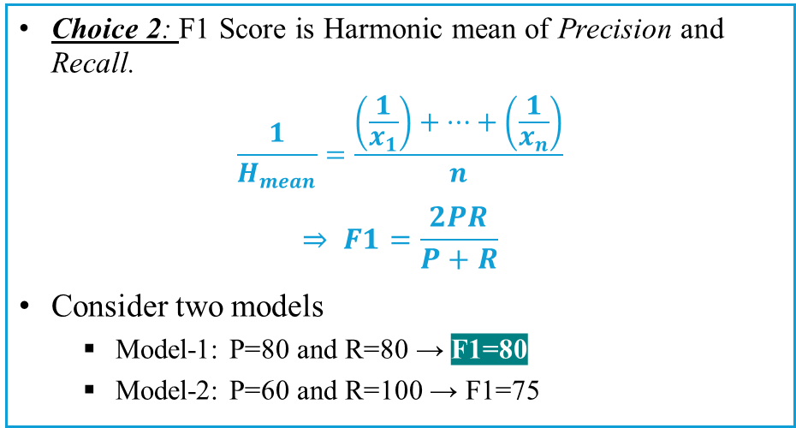
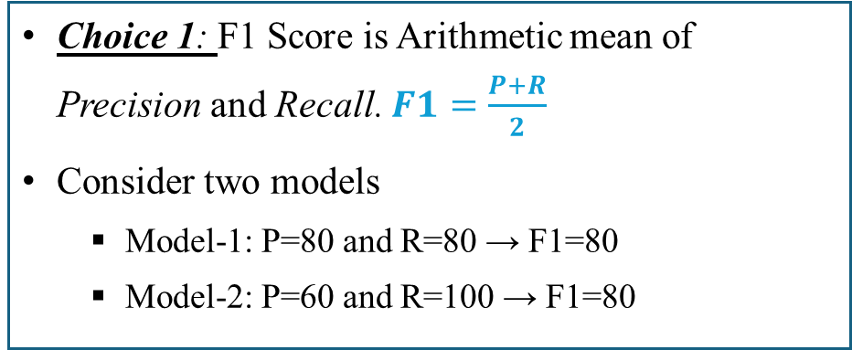
Classification Metrics
F1 Score
Consider a dog vs. cat classification [Class 1 (dogs) and Class 0 (Cats)]
Type-I or Type-II error is important!!
Such problems require balance between Precision and Recall.
F1 Score is derived from Precision and Recall.
Choice 1: F1 Score is Arithmetic mean of Precision and Recall. $F1=\frac{P+R}{2}$
Consider two models
Model-1: P=80 and R=80 → F1=80
Model-2: P=60 and R=100 → F1=80
Choice 2: F1 Score is Harmonic mean of Precision and Recall.
$$\frac{1}{H_{mean}}=\frac{\left(\frac{1}{x_{1}}\right)+…+\left(\frac{1}{x_{n}}\right)}{n}$$
$$⇒ F1=\frac{2PR}{P+R}$$
Consider two models
Model-1: P=80 and R=80 → F1=80
Model-2: P=60 and R=100 → F1=75
Harmonic mean always tends towards the lower numbers
Arithmetic mean gives the exact mid-point of two numbers

Slide 16
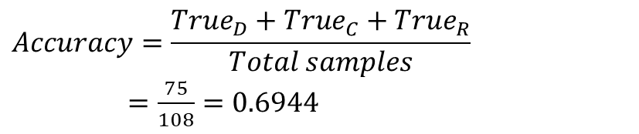
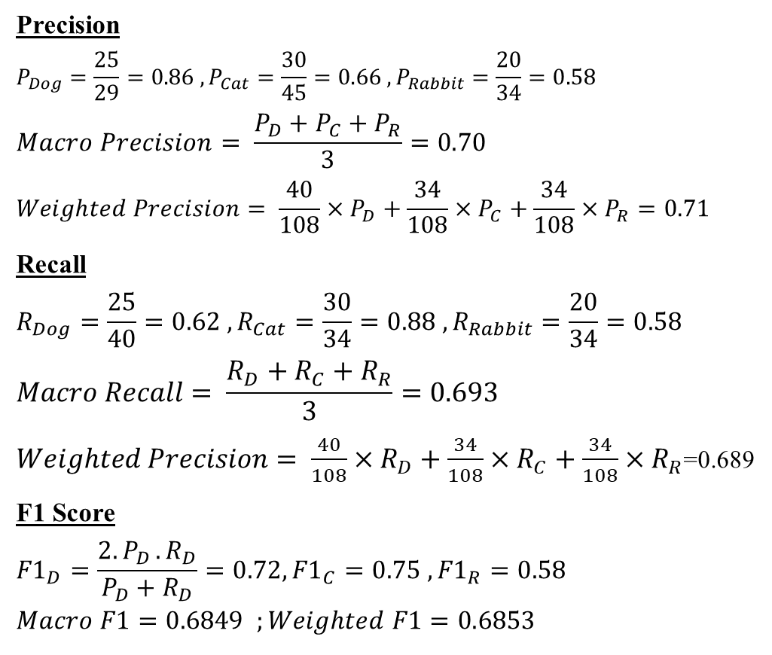
Classification Metrics
Accuracy, Precision, Recall, F1-Score in Multi-class classification
Precision
$$P_{Dog}=\frac{25}{29}=0.86 , P_{Cat}=\frac{30}{45}=0.66 , P_{Rabbit}=\frac{20}{34}=0.58$$
$$Macro Precision= \frac{P_{D}+P_{C}+P_{R}}{3}=0.70$$
$$Weighted Precision= \frac{40}{108}×P_{D}+\frac{34}{108}×P_{C}+\frac{34}{108}×P_{R}=0.71$$
Recall
$$R_{Dog}=\frac{25}{40}=0.62 , R_{Cat}=\frac{30}{34}=0.88 , R_{Rabbit}=\frac{20}{34}=0.58$$
$$Macro Recall= \frac{R_{D}+R_{C}+R_{R}}{3}=0.693$$
$Weighted Precision= \frac{40}{108}×R_{D}+\frac{34}{108}×R_{C}+\frac{34}{108}×R_{R}$=0.689
F1 Score
$${F1}_{D}=\frac{2{.P}_{D}.R_{D}}{P_{D}+R_{D}}=0.72, {F1}_{C}=0.75 , {F1}_{R}=0.58$$
$$Macro F1=0.6849 ;Weighted F1=0.6853$$
 | Dog | Cat | Rabbit | Total
Dog | 25 | 5 | 10 | 40
Cat | 0 | 30 | 4 | 34
Rabbit | 4 | 10 | 20 | 34
Total | 29 | 45 | 34
$$Accuracy=\frac{{True}_{D}+{True}_{C}+{True}_{R}}{Total samples}$$
$=\frac{75}{108}=0.6944$

Slide 17
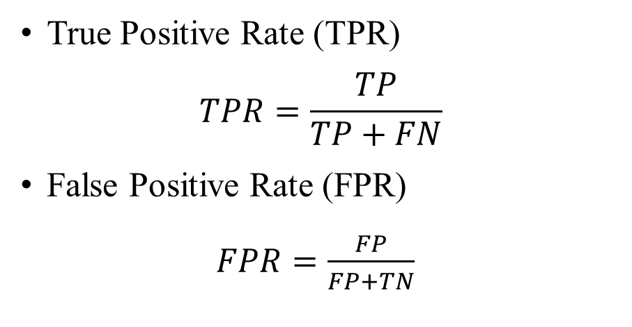
Classification Metrics
How to choose a good threshold?
ROC Curve
Training Set
True Positive Rate (TPR)
$$TPR=\frac{TP}{TP+FN}$$
False Positive Rate (FPR)
$FPR=\frac{FP}{FP+TN}$
Spam Classifier Model
Spam Score
Score >= Threshold?
No
Yes
ROC is FPR vs. TPR
It show the performance of the model at all the thresholds in [0, 1]
Not Spam
Spam

Slide 18
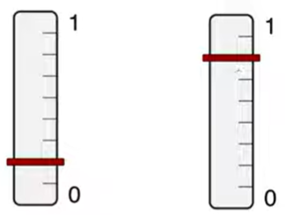
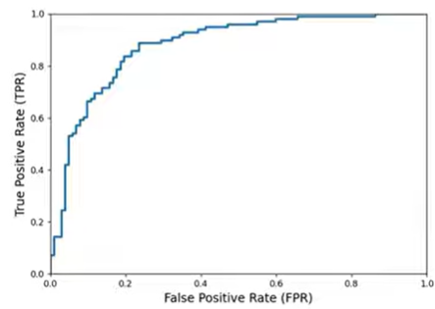
Classification Metrics
ROC Curve
Dots are examples:
Green = positive label, gray = negative label.
Consider score to be probability output of Logistic Regression.
Position of example on scoring line based on model output
Score = 1
Thres = 1.00
Low threshold
Perfect Threshold
Low threshold
High threshold
TPR
FPR
TPR
FPR
High threshold
Thres = 0.00
Score = 0

Slide 19
Classification Metrics
Score = 1
Thres = 1.00
Threshold | TP | TN | FP | FN | Accuracy | Precision | Recall (TPR) (Sensitivity) | Specificity (FPR) | F1
1.00 | 0 | 10 | 0 | 10 | 0.50 | 1 | 0 | 1 | 0
0.95 | 1 | 10 | 0 | 9 | 0.55 | 1 | 0.1 | 1 | 0.182
0.90 | 2 | 10 | 0 | 8 | 0.60 | 1 | 0.2 | 1 | 0.333
0.85 | 2 | 9 | 1 | 8 | 0.55 | 0.667 | 0.2 | 0.9 | 0.308
0.80 | 3 | 9 | 1 | 7 | 0.60 | 0.750 | 0.3 | 0.9 | 0.429
0.75 | 4 | 9 | 1 | 6 | 0.65 | 0.800 | 0.4 | 0.9 | 0.533
0.70 | 5 | 9 | 1 | 5 | 0.70 | 0.833 | 0.5 | 0.9 | 0.625
0.65 | 5 | 8 | 2 | 5 | 0.65 | 0.714 | 0.5 | 0.8 | 0.588
0.60 | 6 | 8 | 2 | 4 | 0.70 | 0.750 | 0.6 | 0.8 | 0.667
0.55 | 7 | 8 | 2 | 3 | 0.75 | 0.778 | 0.7 | 0.8 | 0.737
0.50 | 8 | 8 | 2 | 2 | 0.80 | 0.800 | 0.8 | 0.8 | 0.800
0.45 | 9 | 8 | 2 | 1 | 0.85 | 0.818 | 0.9 | 0.8 | 0.857
0.40 | 9 | 7 | 3 | 1 | 0.80 | 0.750 | 0.9 | 0.7 | 0.818
0.35 | 9 | 6 | 4 | 1 | 0.75 | 0.692 | 0.9 | 0.6 | 0.783
0.30 | 9 | 5 | 5 | 1 | 0.70 | 0.643 | 0.9 | 0.5 | 0.750
0.25 | 9 | 4 | 6 | 1 | 0.65 | 0.600 | 0.9 | 0.4 | 0.720
0.20 | 9 | 3 | 7 | 1 | 0.60 | 0.562 | 0.9 | 0.3 | 0.692
0.15 | 9 | 2 | 8 | 1 | 0.55 | 0.529 | 0.9 | 0.2 | 0.667
0.10 | 9 | 1 | 9 | 1 | 0.50 | 0.500 | 0.9 | 0.1 | 0.643
0.05 | 10 | 1 | 9 | 0 | 0.55 | 0.526 | 1 | 0.1 | 0.690
0.00 | 10 | 0 | 10 | 0 | 0.50 | 0.500 | 1 | 0 | 0.667
Thres = 0.00
Score = 0

Slide 20
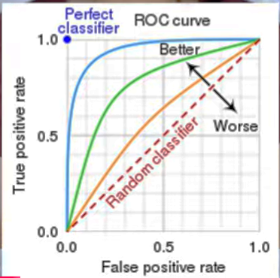
Classification Metrics
AUC-ROC
It is the area under the ROC curve.
It provides the aggregate performance across all possible thresholds
An AUC of 1 indicates that model has perfect discrimination – the best
An AUC of 0.5 suggests has no discrimination ability – it is as good as a random classification
An AUC of 0 indicates that the model is completely wrong. It classifies all positive examples as negative and all negatives as positive.
In practice, AUC value fall between 0.5 (random) and 1.0 (perfect).

